Slide 1
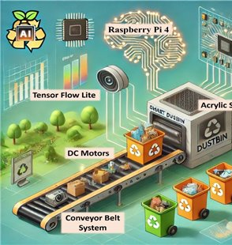
IT4010 – Progress Presentation 2 (PP2)
25-26J-386 | Fitnourish.Ai

Slide 2
Problem Statement & Stakeholders
Context :
Health and nutrition management using mobile health applications.
Stakeholders:
Primary Users: Individuals who want to improve diet and health
Secondary Users: Fitness trainers and nutrition advisors
Decision Makers: Healthcare providers and wellness platforms
Observed Issue: Many diet and fitness apps provide static recommendations and do not use real-time health data.
Why It Matters:
Users receive inaccurate diet advice
Poor diet planning leads to health risks
Users spend more time and money on ineffective meal planning

Slide 3
Research Gap & Objectives
Research Gap: Most existing nutrition apps:
Do not use real-time health data
Do not combine health monitoring, meal analysis, and grocery optimization
Do not provide cost-aware food recommendations
Main Objective:
To provide users with personalized nutrition targets, health insights, and cost- effective food recommendations by analysing ->
Health data
Activity patterns
Meal images
Grocery prices

Slide 4
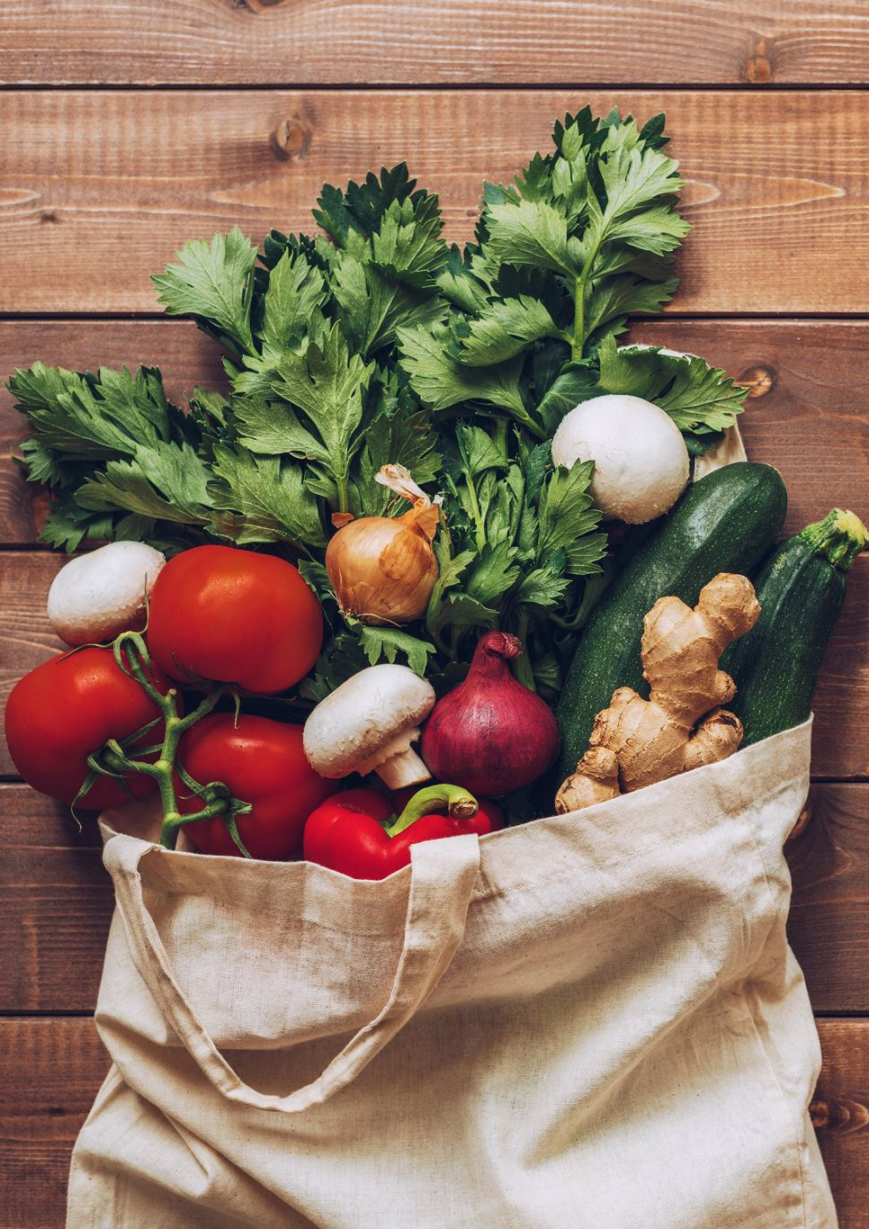
Solution Overview (What We Built)
Solution Summary:
FitNourish.AI is an AI-powered mobile nutrition assistant that provides personalized diet guidance and cost-aware grocery recommendations.
Key Features Delivered:
FR1 — AI Nutrition Target Prediction FR2 — Meal Image Analysis & Meal Planning FR3 — Health Monitoring & Alerts FR4 — Smart Grocery List Optimization
Non-Functional Focus:
Performance (Fast API responses)
Usability (Mobile-first UI)
Reliability (Validated inputs)
Scalability (Modular architecture)
Current Completion Status:
System development is approximately 90% completed.

Slide 5

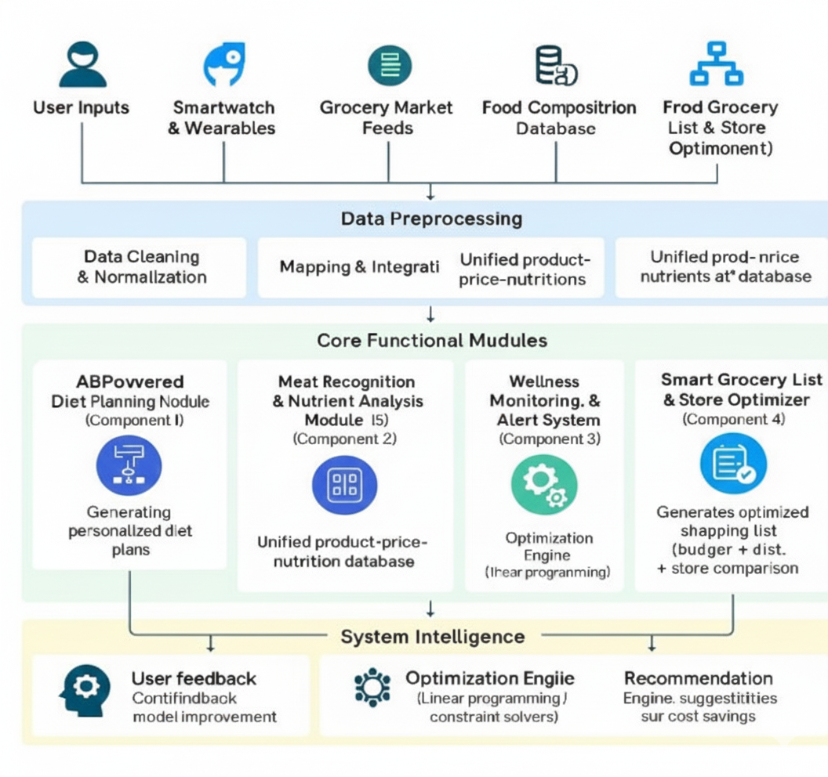
System Architecture & Integration
System Architecture Diagram
Notes:
Show one clear diagram. Explain data flow end-to-end. Mention interfaces and consistency.

Slide 6

IT22907684|Weerarathne H.P
1.AI-powered Multi-Disease Adaptive Nutrition
and Personalized Health Optimization
Integration Points
Mobile App → FastAPI Backend (REST / JSON)
Backend → Random Forest Model (Python object inference)
Smartwatch/Health Data → Mobile App (Health Connect / structured health fields)
Backend → Mobile App (JSON prediction response)
Deployment / Runtime Setup
Frontend: React Native app on Android
Backend: FastAPI on local machine
Model: Random Forest running in backend
Setup: Single-machine development environment

Slide 7
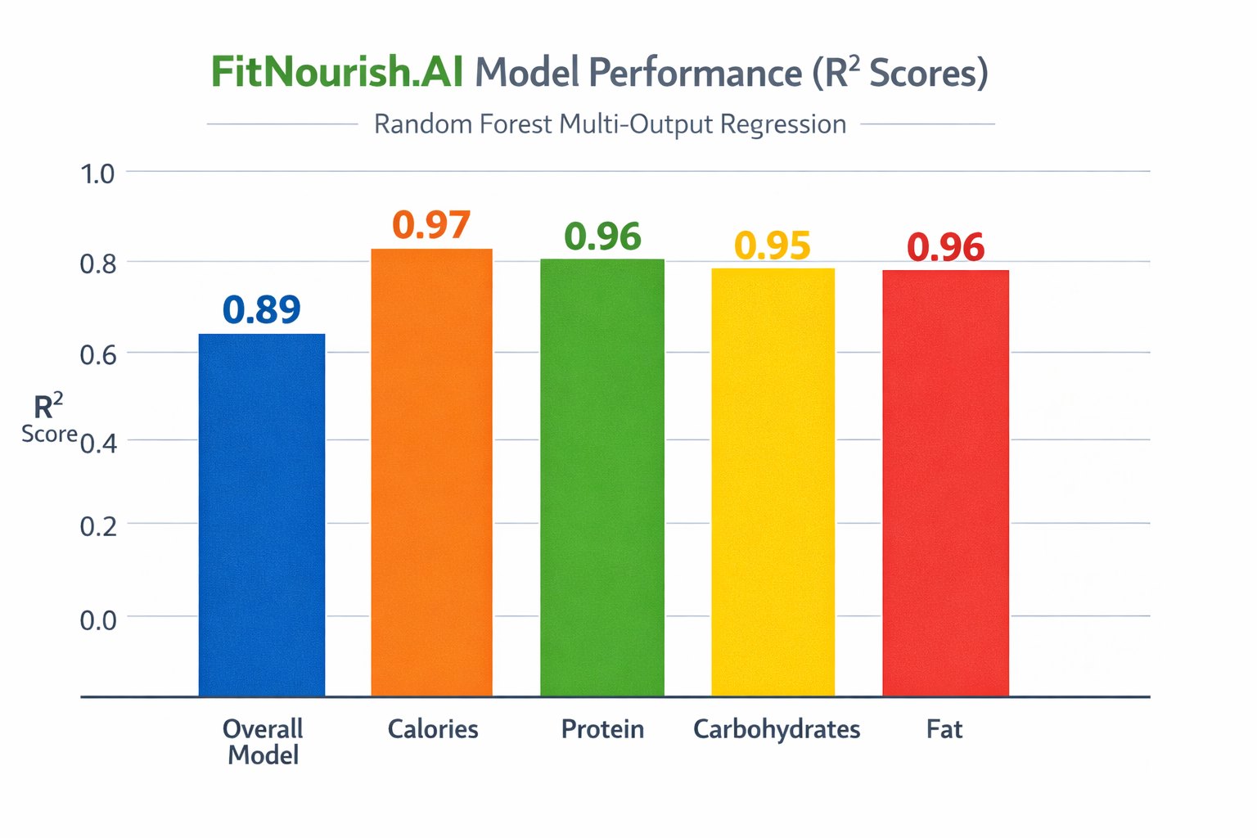
Model & Accuracy

Slide 8

IT223434352|Ekanayake M.Y.R
2.AI-powered Dynamic Meal Generator and Visual Ingredient Identifier
Integration points:
Mobile App: React Native application deployed on Android with Expo.
AI Intelligence: Integration of Food Analysis and Meal Plan Generation models to provide personalized nutritional insights.
Health Connect Integration - Automatically fetches the most recent Calorie Prediction by User ID from the database for meal plan generation.
Cloud Database – for storing personalized meal plans
Deployment /run time setup:
Frontend: React Native app on Android devices
Backend: FastAPI on local machine to manage request handling and prediction logic.
Setup: Single-machine development environment

Slide 9
Model & Accuracy
Meal Plan Generator:
Optimization Algorithm: Integer Linear Programming (ILP)
Model Accuracy: 84.58%
Meal Analysis:
Base Model: EfficientNetV2BO (CNN)
Ingredient Prediction - Multi-Label Classification Model
75 classes for each ingredient
Nutrition Prediction — Multi-Task Regression Model
3 regression outputs for protein, fat and carbohydrates
Model Accuracy: 74.11% (25% tolerance)
Dataset – Nutritions5k

Slide 10

IT22343420|T.M Poornima 3.AI-powered Predictive Health Alert Progress Tracking System
Integration points:
Mobile Application: React Native (Expo) mobile app used for collecting user health data such as blood pressure, exercise hours, and daily food intake.
AI Prediction Models: Integration of Health Risk Prediction and Diet Recommendation models to generate personalized health insights based on user data.
Calorie Target Integration: Retrieves the user’s daily calorie target from the Nutrition Analysis module to compare with daily calorie intake.
Cloud Database: MongoDB database used to store user health records, activity logs, prediction results, and health progress data.
Deployment /run time setup:
Frontend: React Native (Expo) mobile app running on Android devices for health data input, predictions, and progress tracking.
Backend: FastAPI server running on a local machine to process health data, execute Health Risk Prediction and Diet Recommendation models, and handle API requests.
Database Setup: MongoDB used for storing user health records, daily activities, prediction results, and health progress in a single-machine development environment.

Slide 11
Model & Accuracy
Health Risk Prediction Model:
Training Algorithm: XGBoost Classifier
Prediction Type – Classification Model for predicting user health risk level (Low, Moderate, High)
Model Accuracy: 89.9%
Diet Recommendation Model:
Training Algorithm: Gradient Boosting Classifier
Prediction Type – Classification Model for generating personalized diet recommendations
Model Accuracy: 67.36%

Slide 12

IT22343284|Samarawikrama T.N 4.AI-powered Smart Grocery List Optimization and Nearest Store Recommendation
Integration Points
Mobile App : React Native (Expo) app used for grocery item search and user interaction.
Supermarket Data Integration : Uses real-time supermarket data scraped from Keells (Curl ) and Cargills (Playwright )
Data Processing Pipeline : Transforms raw supermarket data into structured product records (clean , categoriz )
External Integration : Google Maps API, Haversine formula , AI insights integration via OpenAI API.
Deployment / Runtime Setup
Frontend: React Native mobile application built with Expo, running on Android devices.
Backend: REST API developed using FastAPI, running on the local machine.
Development Environment: Single-machine development environment.

Slide 13
Optimization Logic & System Algorithms
1. Distance Calculation Model : Calculates store distance using Google Maps API and Haversine formula.
2. Price Comparison Engine : Compares the latest product prices across Keells and Cargills supermarkets.
3. Multi-Store Basket Analysis : Calculates the total grocery basket cost for each store and recommends the cheapest option.
4.System Approach : Rule-based cost optimization using price and distance analysis.

Slide 14
Commercialization
Target users / Market
Individuals (25–65) with chronic diseases
Health- Aware smartphone users
Clinics, insurers, corporate wellness programs
Supermarket chains
Value proposition
Personalized nutrition guidance
Uses real-time health data
Supports multi-disease management
Cost and feasibility
Subscription-based mobile app
SaaS for clinics and organizations
Low operational cost, scalable system
Adoption plan / Next steps
Pilot with small user group/clinics
Collect feedback and improve system
Expand through healthcare partnerships
Unique selling point s it’s a all in one application separate 4 apps in one appication

Slide 15
Thank You !

